Slide 1


Slide 2
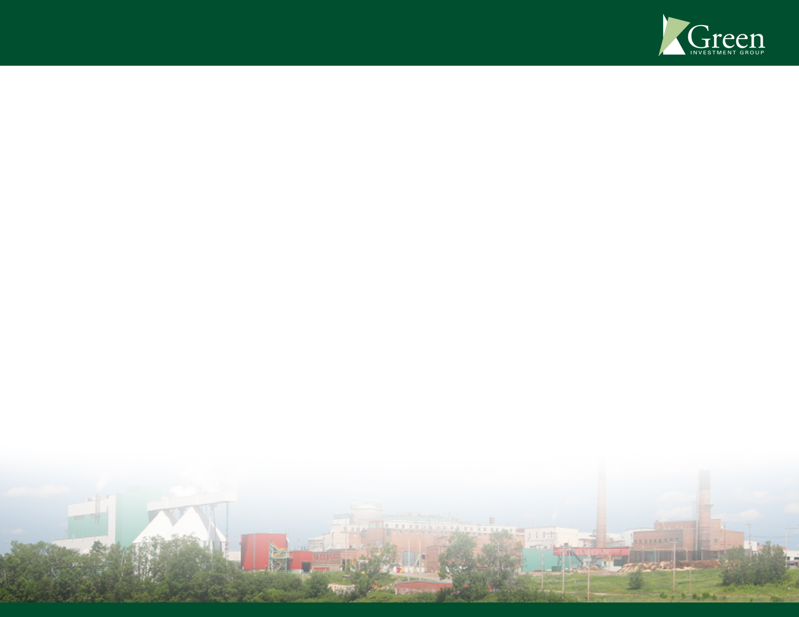
Green Investment Group, Inc. Company Profile
Green Investment Group, Inc. (GIGI) was formed in 2005 to acquire, remediate and redevelop the Smurfit-Stone paper mill site at Alton, Illinois. GIGI’s principal was one of the formation shareholders of Alton Steel, Inc., which acquired the 90 year old bankrupt Laclede Steel mill site in Alton, Illinois.
GIGI is dedicated to developing brownfields in a manner that complements community needs, and is committed to working in partnership with local municipalities, associations and businesses to bring the best opportunities to this area.
GIGI is one of seven, single-purpose entities formed by its principals to acquire Brownfield properties in Canada and the U.S. Although legally and operationally distinct, these companies share a common purpose to remediate and redevelop the particular property each company owns.

Slide 3
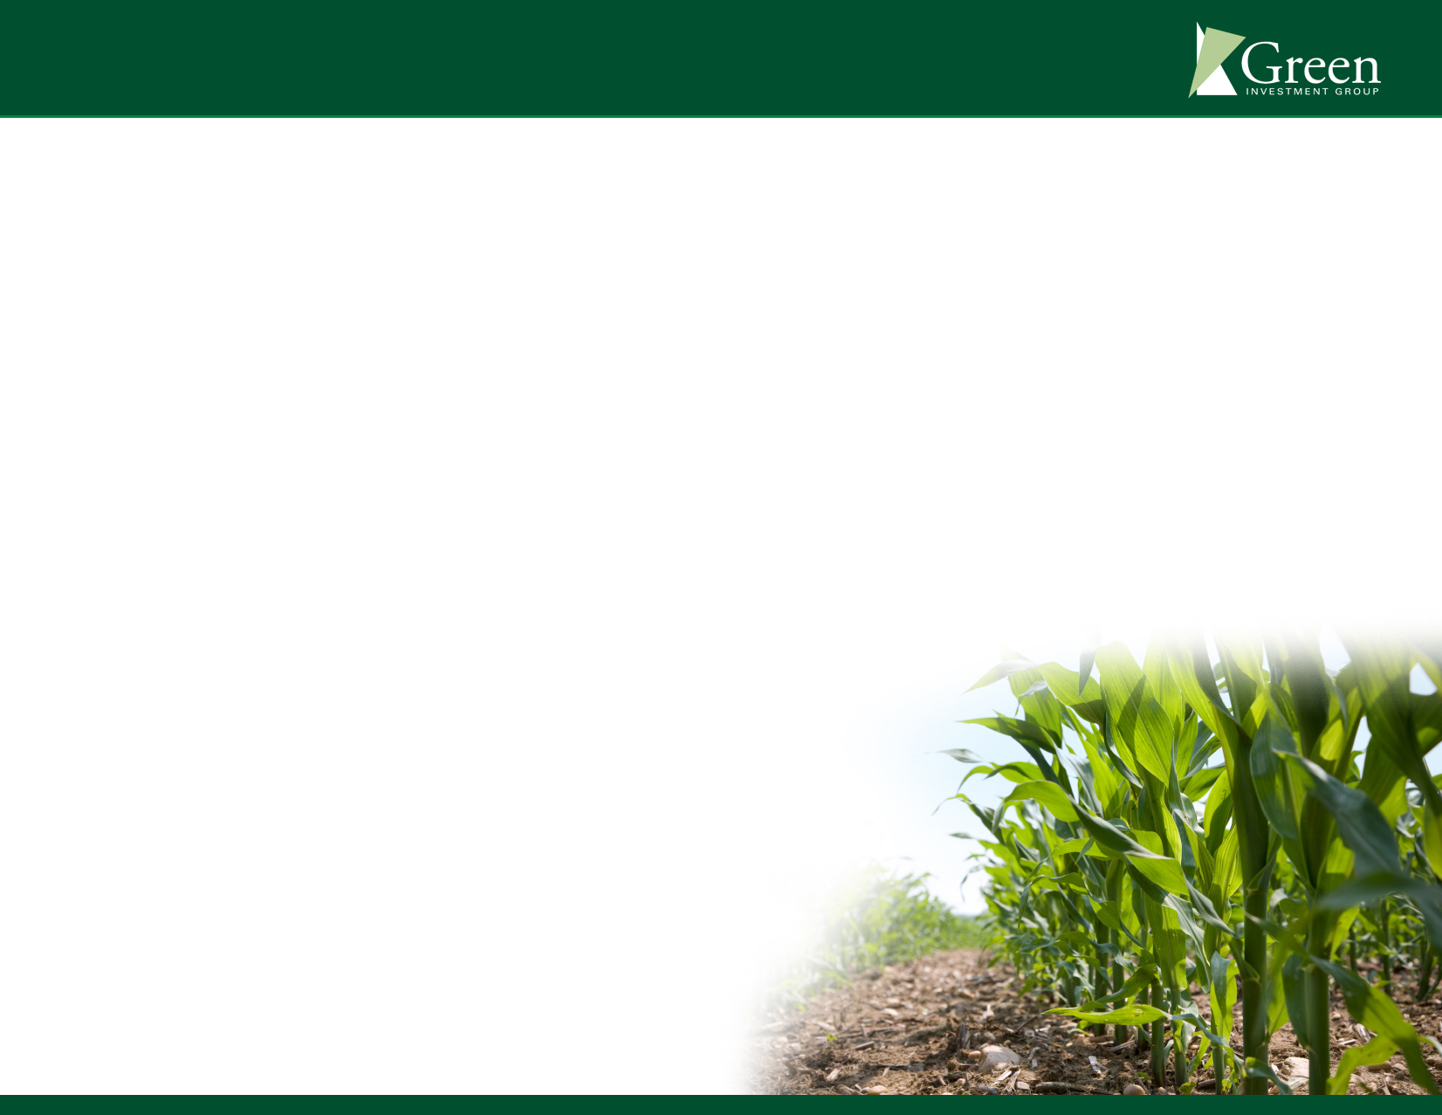
Milestones
Acquired seven Brownfield sites located in Canada and the United States (3 in Canada, 4 in United States)
Developed unique business model dovetailing restoration with revitalization
Focused development efforts on energy technologies, recycling technologies and alternative fuel sources while environmental remediation is underway
Gained support from communities and officials
across all levels of government in both
U.S. and Canada

Slide 4
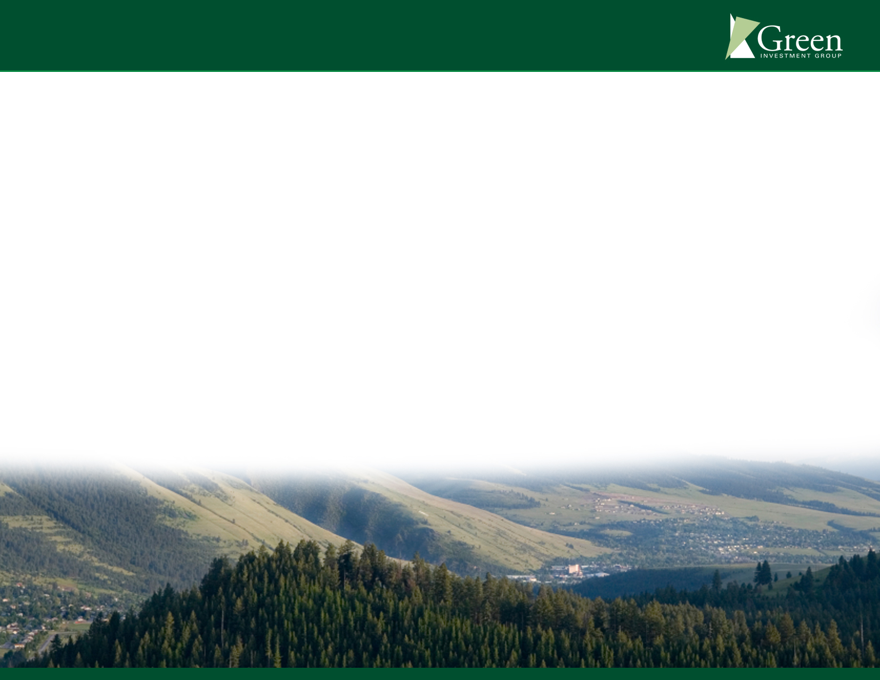
Approach
  Each project follows the business model of:
  Task I: Salvage and Remediate
  Task II: Redevelop & Repopulate
  These two tasks proceed concurrently from the date of acquisition.

Slide 5
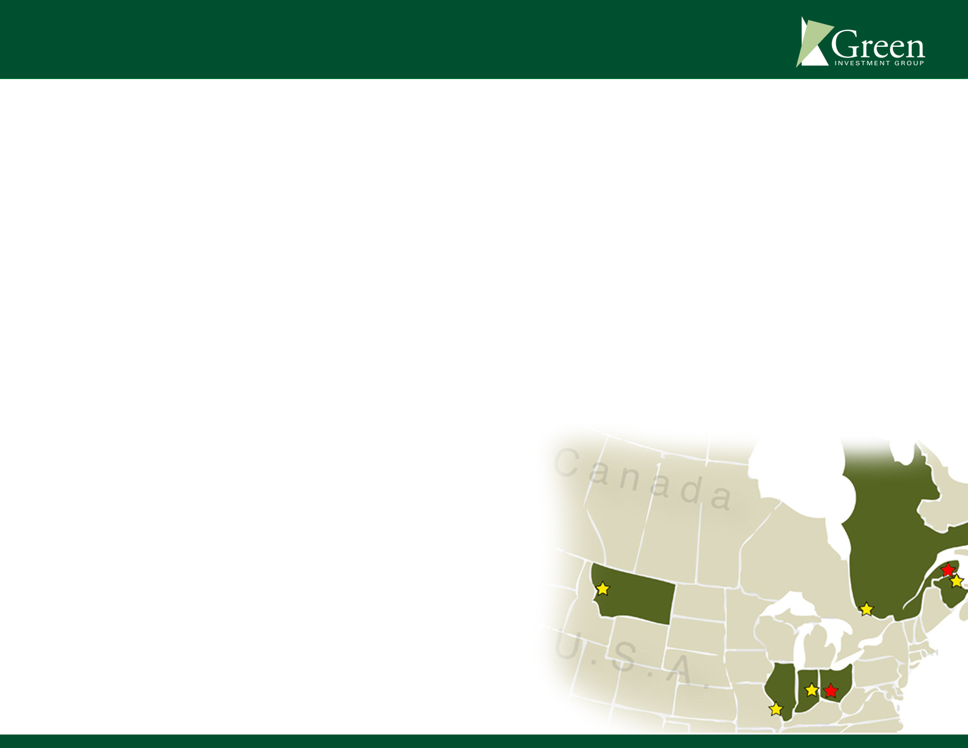
GIGI – Projects
    Alton, Illinois – Remediation completed, draft “No Further Action” letter issued by IL EPA in February 2010
    Circleville, Ohio – Remediation completed, “Covenant Not To Sue” issued by Ohio EPA in 2013, property sold
    Carthage, Indiana – Demolition completed, remediation underway
    Missoula, Montana – Demolition and environmental investigation underway
    New Richmond, Quebec, Canada – Demolition and remediation completed, property sold
    Portage-du-Fort, Quebec, Canada –
    Demolition and remediation completed,
    property partially sold/leased
    Bathurst, New Brunswick, Canada –
    Demolition completed, sales agreement signed

Slide 6

GIGI – U.S. Projects
Project | Size | Origin | Acquired
Alton, Illinois | 635 Acres | 1) Laclede Steel 2) Smurfit-Stone | 2003 2006
Circleville, Ohio | 300 Acres | Smurfit-Stone Mill | 2006
Carthage, Indiana | 180 Acres | Smurfit-Stone Mill | 2009
Missoula, Montana | 3,200 Acres | Smurfit-Stone Mill | 2011

Slide 7
GIGI – Canadian Projects
Project | Size | Origin | Acquired
Bathurst, NB | 165 Acres | Smurfit-Stone Mill | 2010
Portage-du-Fort, QC | 2,200 Acres | Smurfit-Stone Mill | 2010
New Richmond, QC | 165 Acres | Smurfit-Stone Mill | 2010

Slide 8
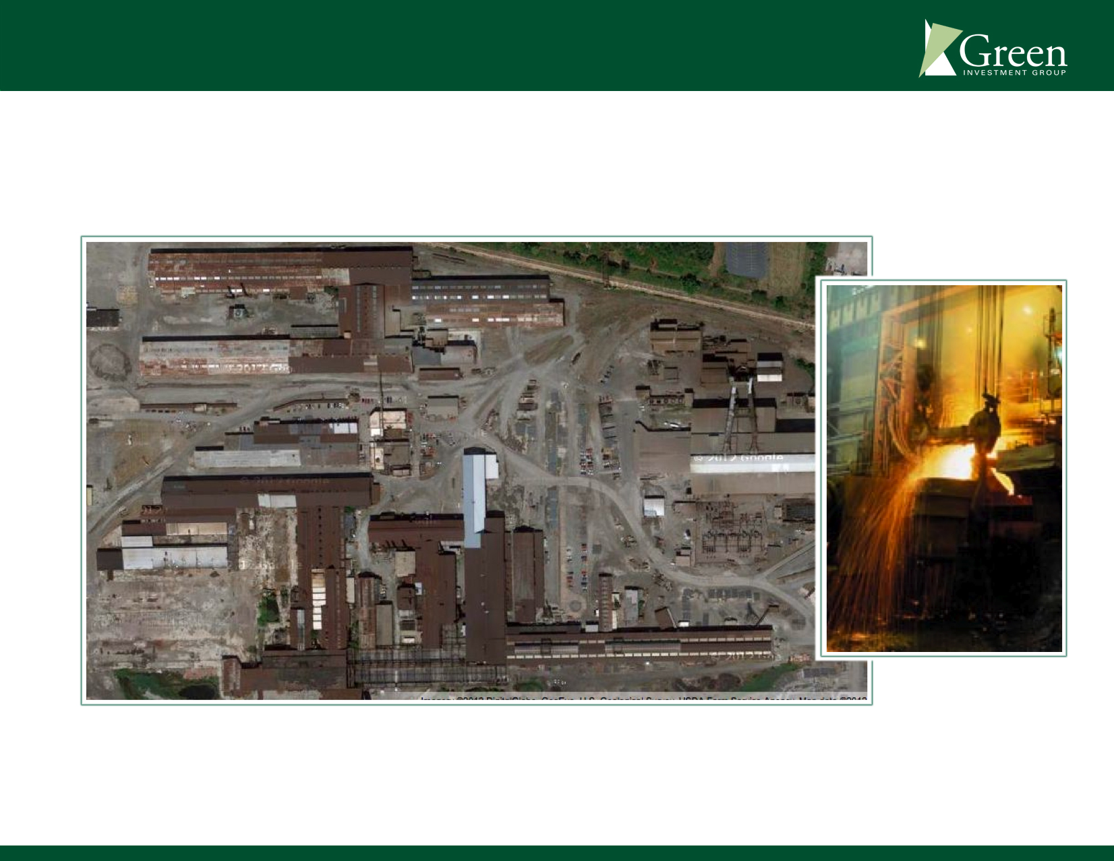
Success Stories-
Alton Steel
Recently celebrated 10 years of operation since restart of bankrupt Laclede Steel.

Slide 9

Alton Smurfit-Stone
Demolition and remediation complete. Illinois EPA issued a draft No Further Action Letter in 2010.

Slide 10
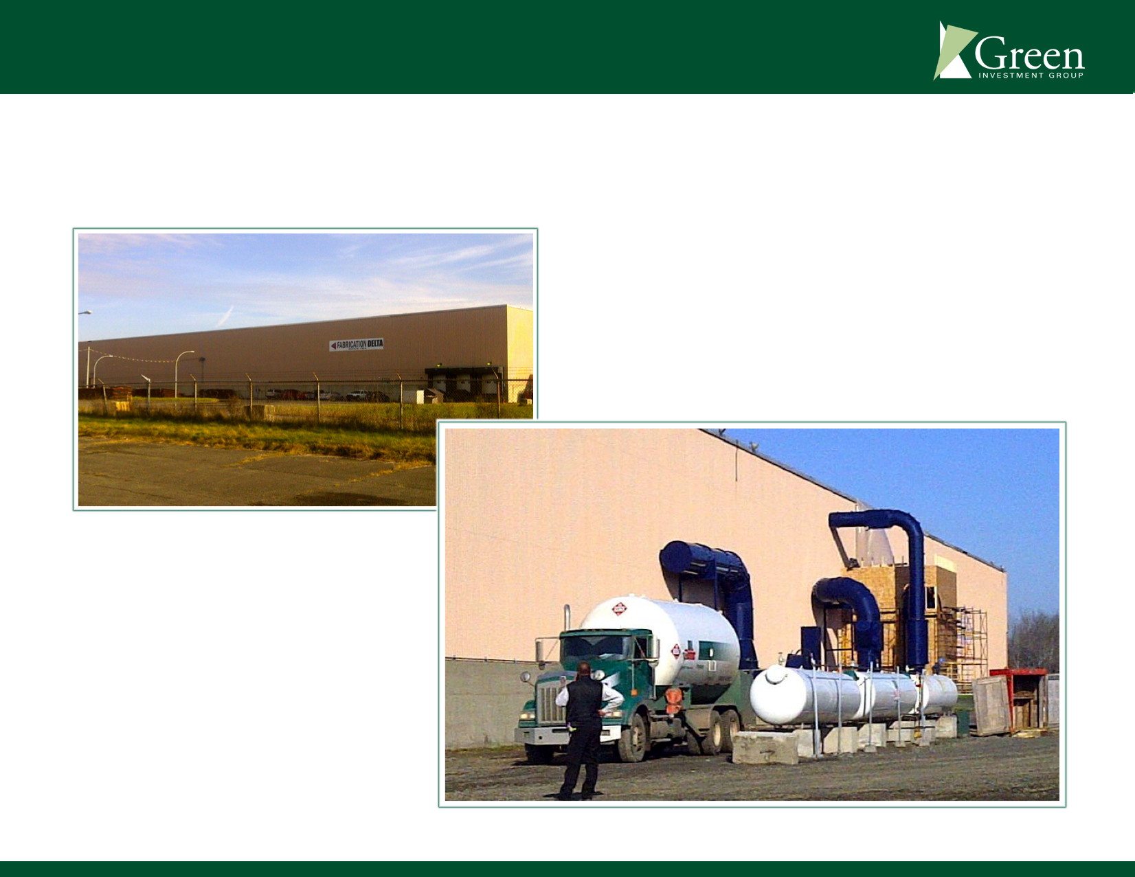
New Richmond, Quebec
Wind Turbine Mast Manufacturing Facility - Lease entered into with Fabrication Delta within 6 months of acquisition.

Slide 11
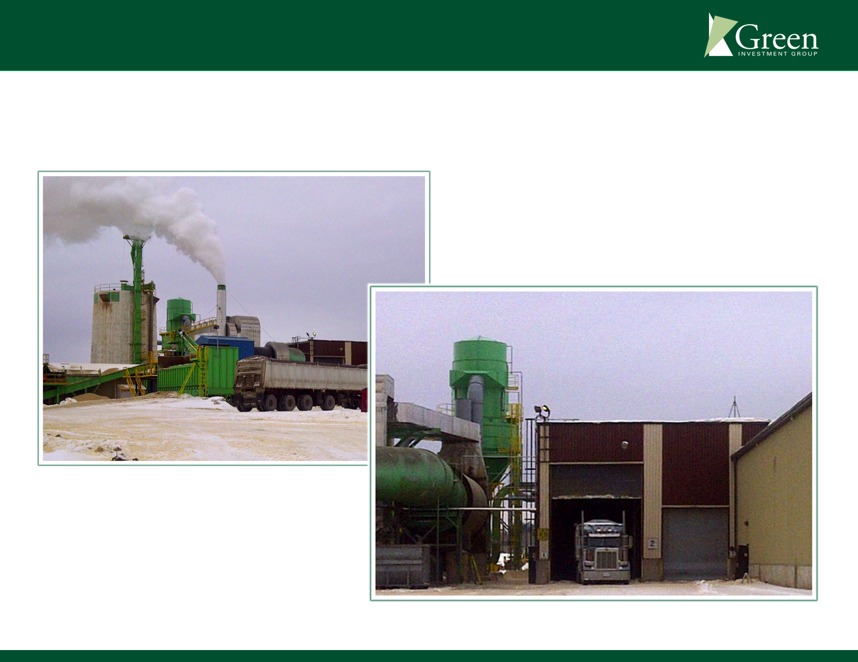
Portage du Fort, Quebec
Wood Pellet Manufacturing Facility – Lease entered into with Trebio within 8 months of acquisition.

Slide 12
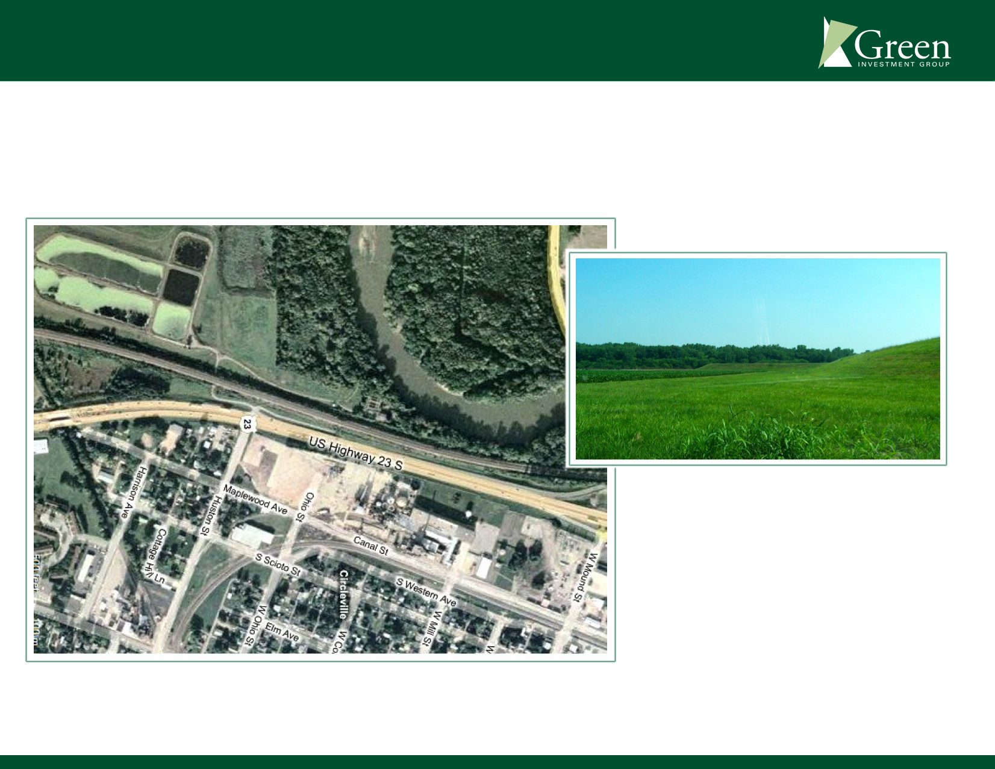
Circleville, Ohio
Ohio EPA issued Covenant Not to Sue. Industrial land sold to Cargill. Agricultural land sold to local rancher.

Slide 13

Progress at Missoula Site Since 2011 Acquisition
Demolition of production assets mostly complete
Meeting with potentially responsible parties and other stakeholders relative to environmental issues
In the process of developing a comprehensive development plan working with an experienced developer from the Northwest
Sold 160-acre agricultural parcel to
local rancher

Slide 14
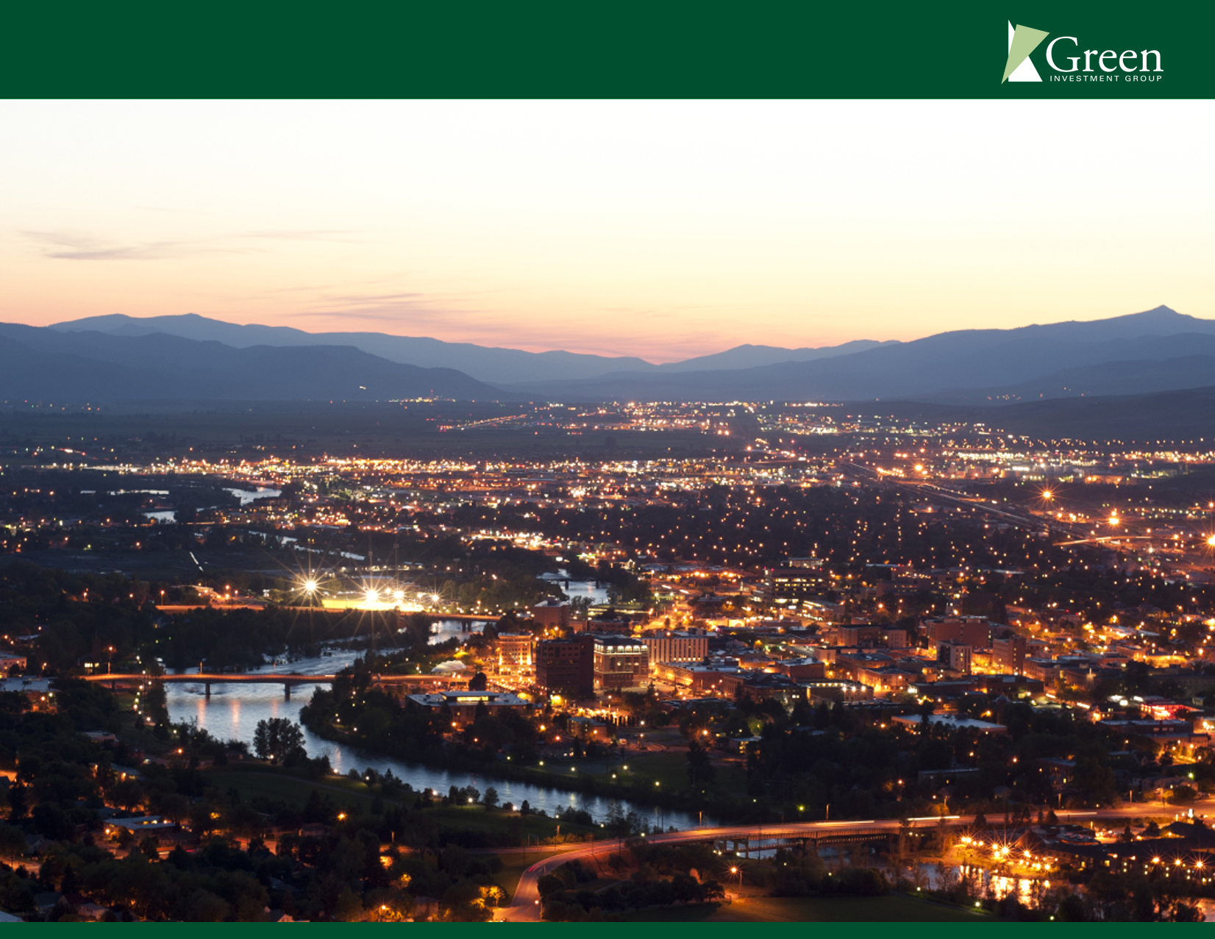
Thank You

